Slide 1
What exactly is useRef?
useRef: is a built-in React Hook that creates a persistent, mutable object that lives for the entire lifecycle of your component.
>It returns a single object with a property called .current.
>When you change the value of .current, React does not trigger a re-render.
It is essentially a "box" where you can store any value (a number, a string, or a reference to a physical HTML element) that survives even when the component "blinks" (re-renders) due to State changes.

Slide 2
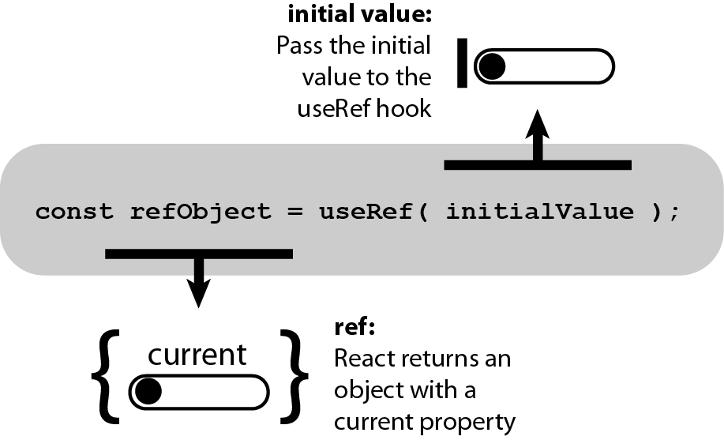
{The }

Slide 3
<>Implementation_example
// 1. Initialize the Ref
const myRef = useRef(0);
// 2. Access or Update the "Box"
console.log(myRef.current); // Reads the value
myRef.current = 10; // Updates the value (Silent!)

Slide 4
><The Two Essential Use Cases
A.Why do we need it?
1. Accessing the DOM (The "Direct Connection")
React usually manages the UI for you. However, some tasks require you to "touch" the HTML directly.
The Manual Play: Playing a video, focusing a cursor in a search bar, or measuring the width of a div.
The Reality: You cannot do these things with State. You need a "pointer" to that specific HTML tag.

Slide 5
<>Implementation_example
const inputRef = useRef(null);
const handleFocus = () => {
// Talking directly to the HTML input element
inputRef.current.focus();
};
return <input ref={inputRef} />;

Slide 6
2.Storing Instance Variables (The "Silent Memory")
Storing Instance Variables (The "Silent Memory")
Sometimes you need to remember a value (like a Timer ID or a previous calculation) across re-renders.
If you use a regular variable (let x = 0), it resets to zero every time the component renders.
If you use useRef, the value stays exactly where you left it, but it doesn't slow down the app by forcing a refresh every time it updates.

Slide 7
3.Technical Comparison (State vs. Ref)
Concept | useState | useRef
Primary Goal | Synchronizing Data with the UI. | Synchronizing Data with the Logic.
The Trigger | Updates the Virtual DOM and re-paints the screen. | Updates the object in memory and remains silent.
Performance | Expensive (Heavy work for the CPU). | Extremely Cheap (Fast memory update).
Data Access | Read-only within the current render. | Read/Write at any time via .current.

Slide 8
4: Real-World Example — The "Input Focus"
Imagine a "Login" modal pops up. To be professional, the "Username" box should be active immediately so the user can start typing.
The Problem: You cannot use useState to focus an input.
The useRef Solution:
You attach a Ref to the <input />.
When the component loads, you call inputRef.current.focus().
The Result: You have bypassed the React rendering cycle to perform a "Native" browser action directly on the hardware.

Slide 9
<>Implementation_example
useEffect(() => {
// This runs once when the component appears
inputRef.current.focus();
}, []);

Slide 10
Professional Scenario: Background Logic
Think of a professional sports timer. It updates every 10 milliseconds.
The Problem: If you store the "Interval ID" in State, you will cause 100 re-renders per second, which will crash the browser or make the UI laggy.
The useRef Solution:
Store the Interval ID inside timerRef.current.
Use useState only for the seconds displayed to the user.
The Result: The "Engine" (the Ref) runs at full speed in the background, while the "Display" (the State) only updates when absolutely necessary.

Slide 11
<>Implementation_example
const timerRef = useRef(null); // The Engine
const [time, setTime] = useState(0); // The Display
const start = () => {
timerRef.current = setInterval(() => {
setTime(t => t + 1);
}, 1000);
};

Slide 12
//Understanding the Lifecycle (Persistence)
When a React component re-renders, the function starts from the top.
Local Variables: (let x = 5) are deleted and re-created. They have "Short-term Memory."
Refs: Are stored by React outside of that specific "render" cycle. They have "Long-term Memory."
Conclusion: Use a Ref whenever you have a value that needs to survive a "Blink" but doesn't need to be seen by the user on the screen.
Teacher’s Strategy: The "Golden Rule"
"If this value changes, does the user need to see a change on the screen right now?"
Yes? -> Use useState.
No? -> Use useRef.

